Slide 1

Stencil Project
Jordan drakos Christopher Grigsby
CSCI*473

Slide 2
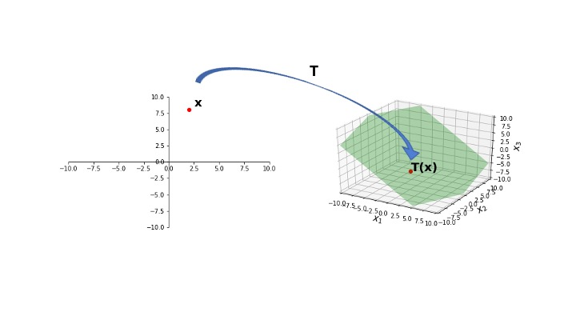

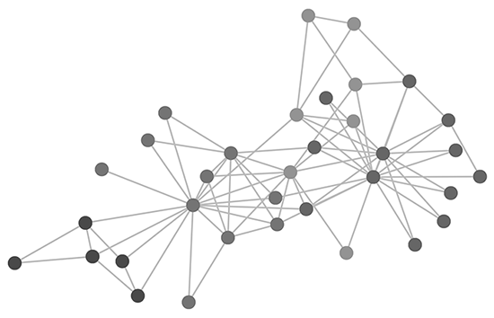

Introduction

Slide 3
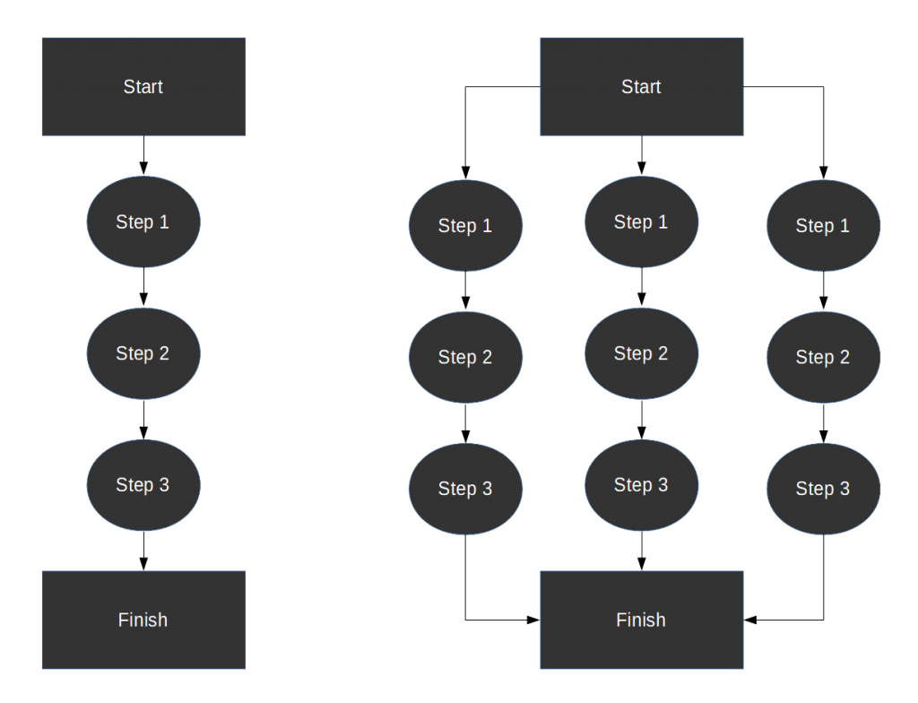
Introduction

Slide 4
Roadmap
Preliminary Knowledge on Parallel Computing
An Overview of Our Experiment
Design
Experimentation
Results Analysis
Matrix Stencil Animations
Conclusion

Slide 5
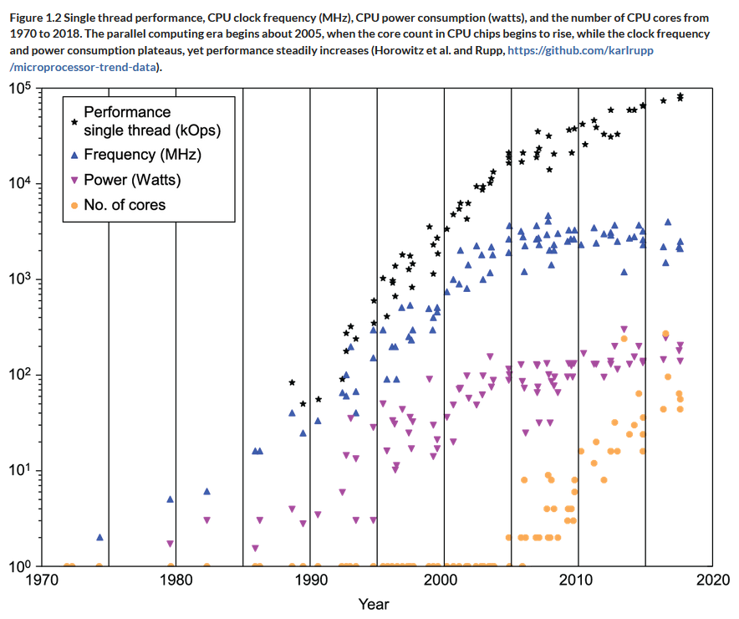
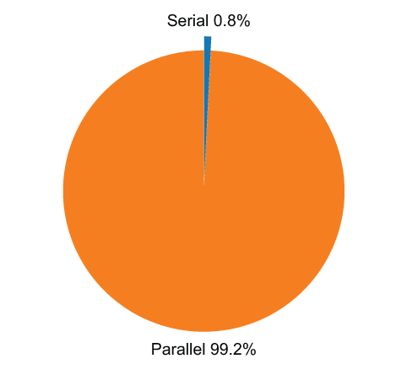

16 cores × 2 hyperthreads × (256 bit-wide vector unit)/(64-bit double) = 128-way parallelism
Preliminary Knowledge on Parallel Computing: Introduction and Motivation

Slide 6
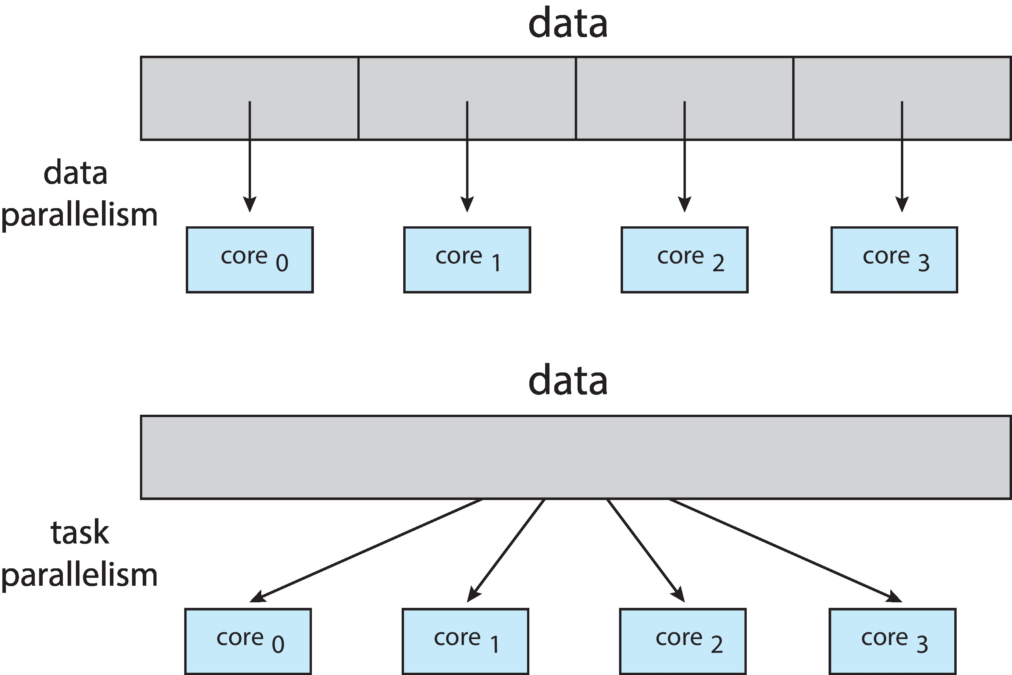
Preliminary Knowledge on Parallel Computing: Types of Parallelism

Slide 7
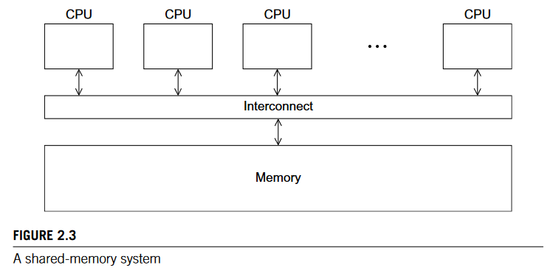
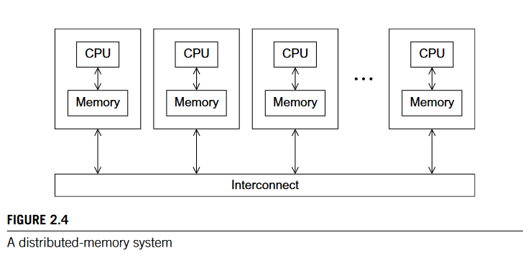
Preliminary Knowledge on Parallel Computing: Shared vs. Distributed Memory Systems

Slide 8
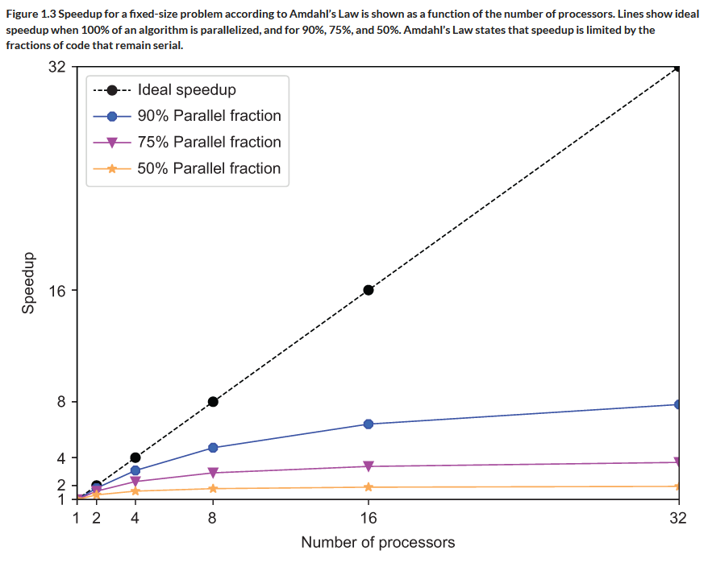
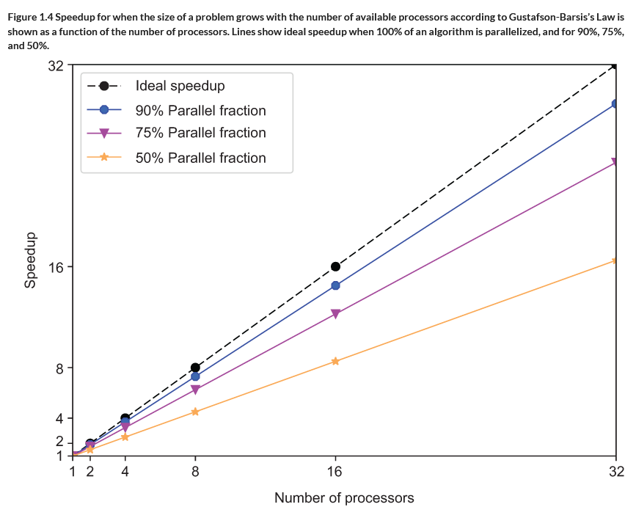
Preliminary Knowledge on Parallel Computing: Amdahl's and Gustafson-Barsis's Laws

Slide 9
Roadmap
Preliminary Knowledge on Parallel Computing
An Overview of Our Experiment
Design
Experimentation
Results Analysis
Matrix Stencil Animations
Conclusion

Slide 10

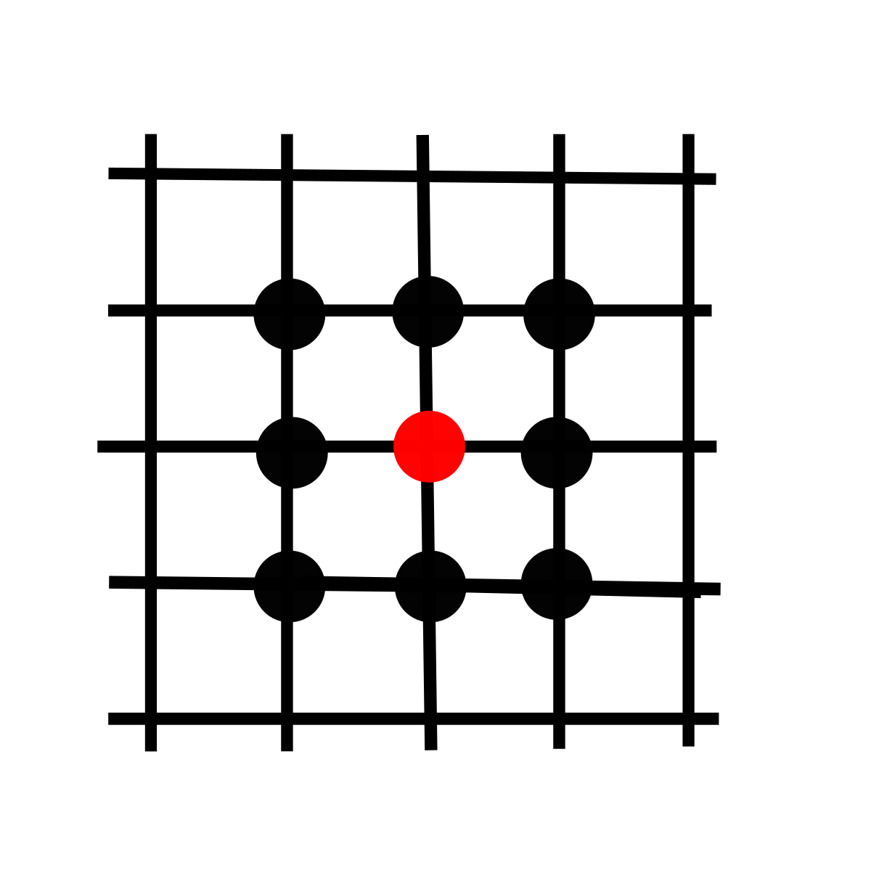
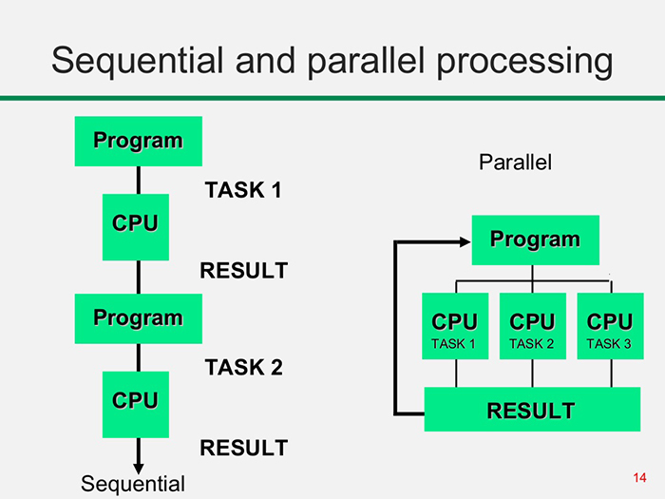
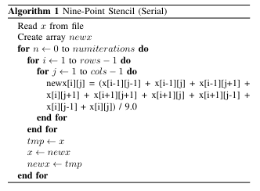
An Overview of Our Experiment

Slide 11


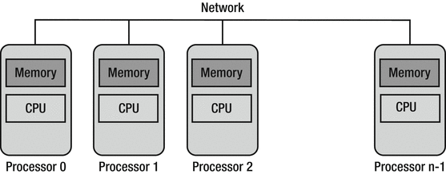
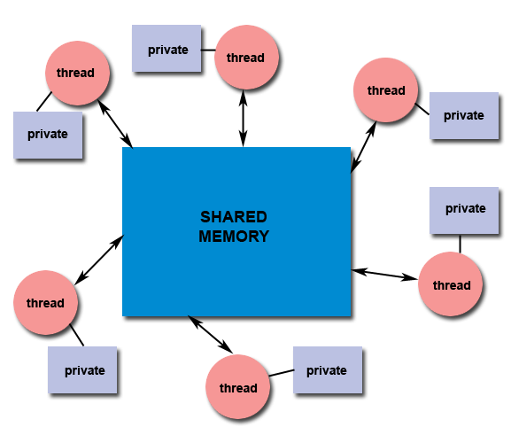
An Overview of Our Experiment

Slide 12
Roadmap
Preliminary Knowledge on Parallel Computing
An Overview of Our Experiment
Design
Experimentation
Results Analysis
Matrix Stencil Animations
Conclusion

Slide 13
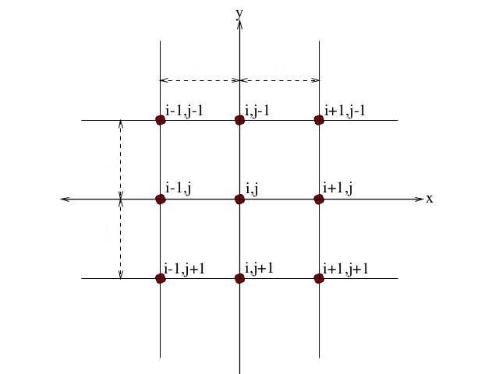
Design: Introduction

Slide 14
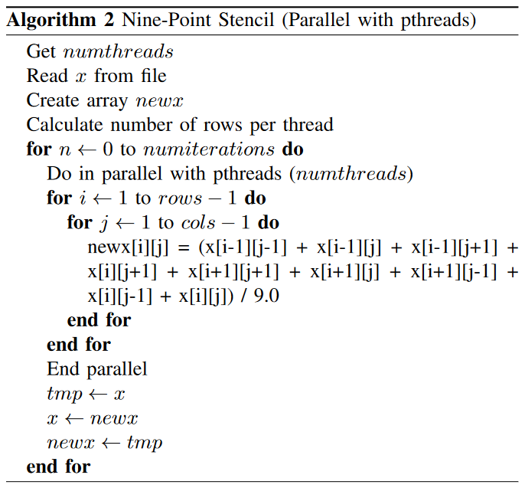
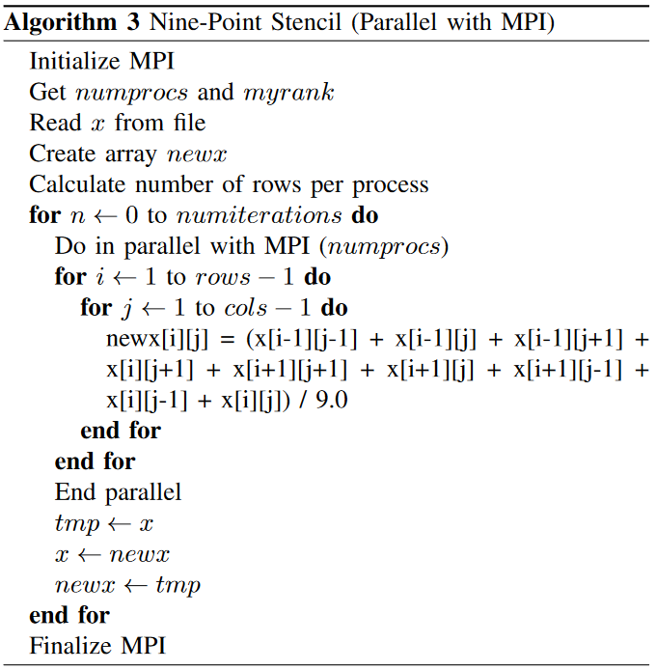
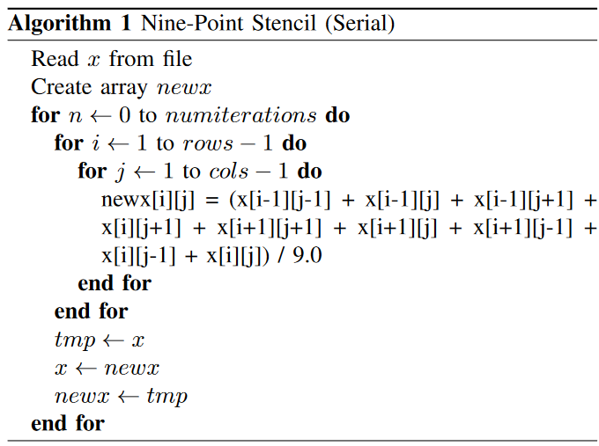
Design: Algorithms

Slide 15
Roadmap
Preliminary Knowledge on Parallel Computing
An Overview of Our Experiment
Design
Experimentation
Results Analysis
Visualizing the Data via Animations
Conclusion

Slide 16
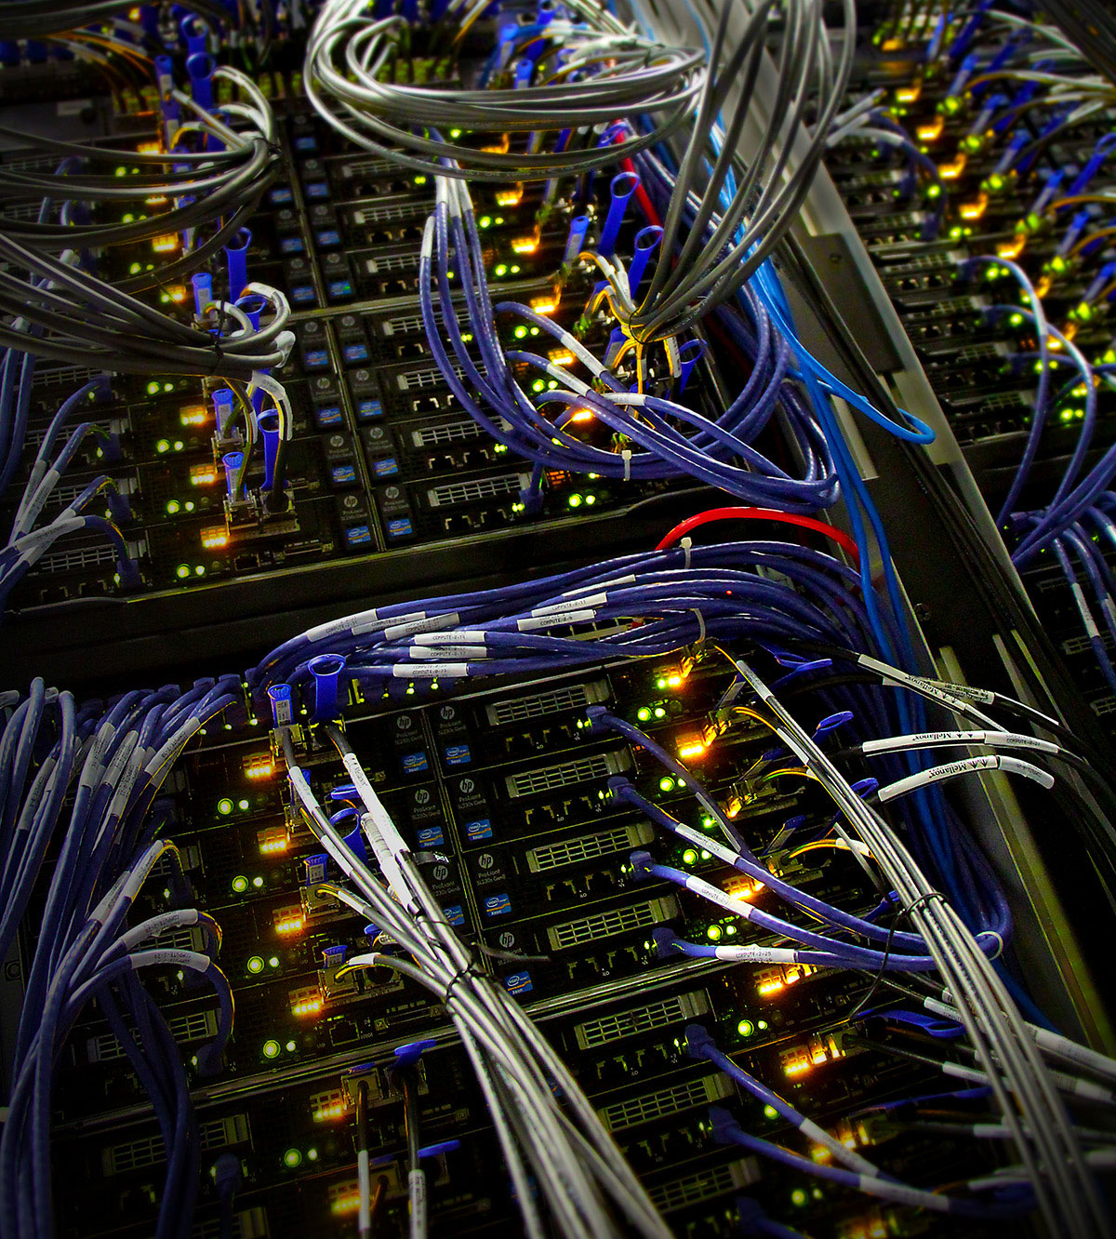


Experimentation

Slide 17
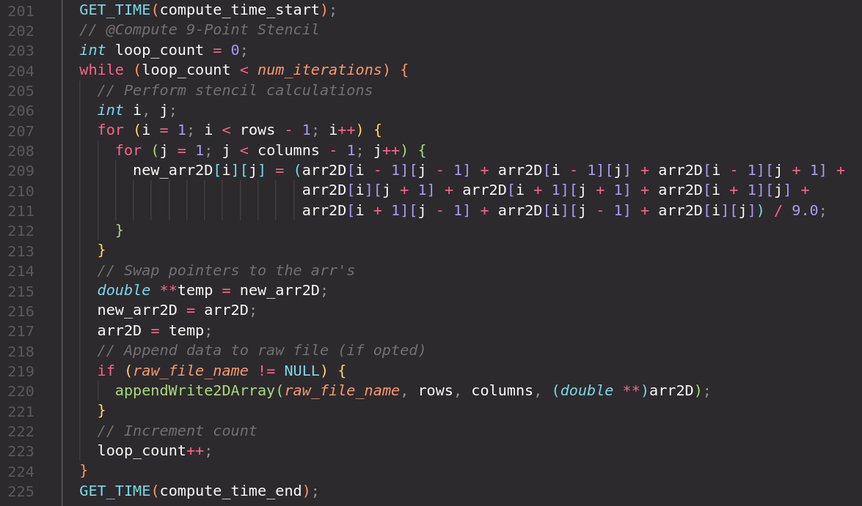
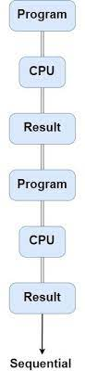
Serial Experiments
1 Node
1 Task per Node Single CPU Core
64GB Memory Matrix Sizes: 1000x1000, 2000x2000, 4000x4000, 16000x16000
Experimentation

Slide 18
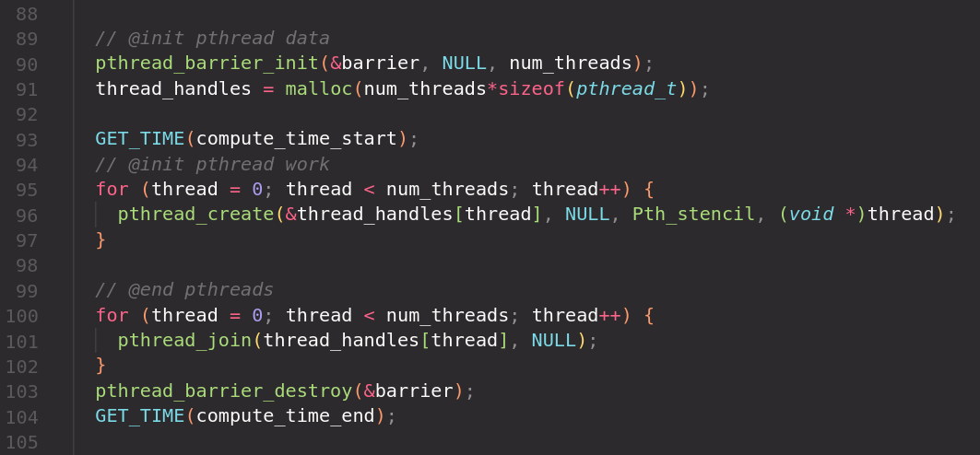
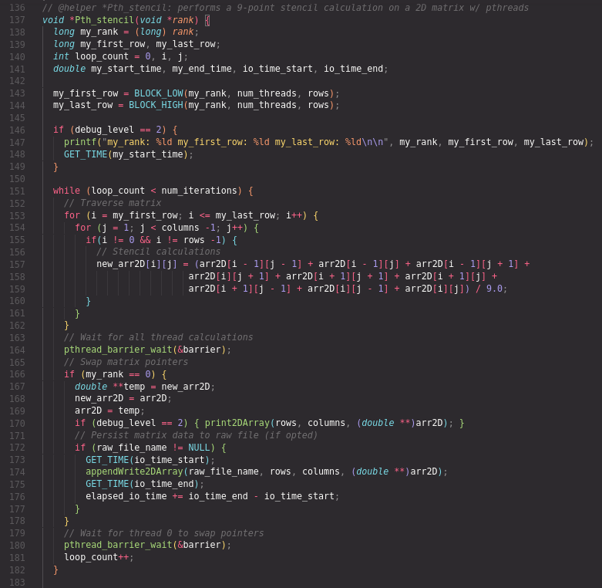
Pthread Experiments
1 Node 1 Task Per Node 16 CPU Cores​ Per Task
64GB Memory​ Threads: 1, 2, 4, 8, 16 Matrix Sizes: ​ 1000x1000, 2000x2000, ​ 4000x4000, 16000x16000​
Experimentation

Slide 19
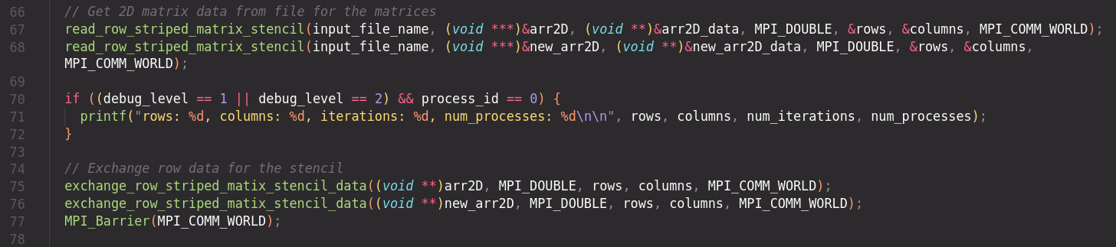
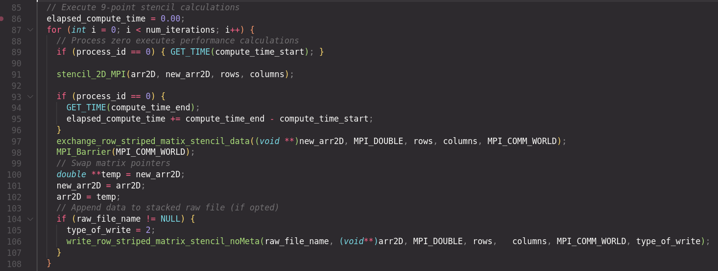
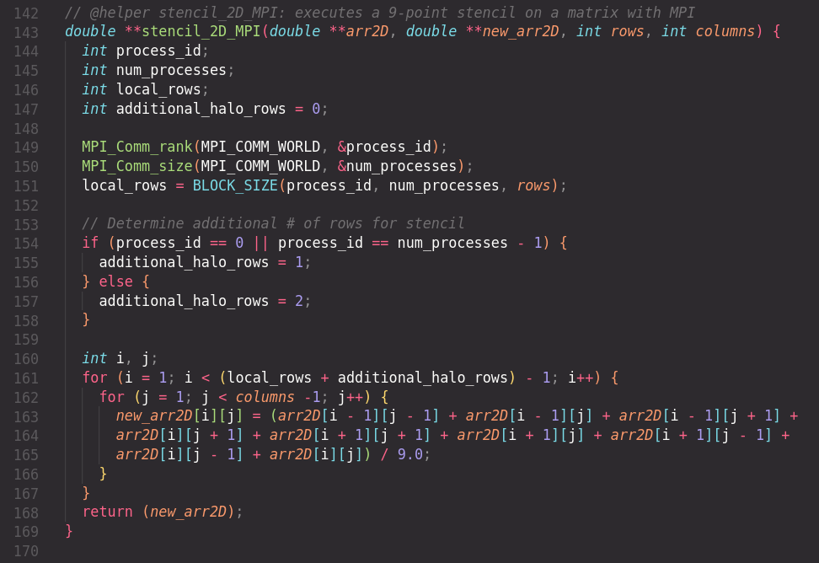
MPI Experiments
1 Node​ 16 Task Per Node​ 1CPU Cores​ Per Task​
64GB Memory​​ Processes: 1, 2, 4, 8, 16​ Matrix Sizes: ​​ 1000x1000, ​ 2000x2000, ​​ 4000x4000, 16000x16000​
Experimentation

Slide 20
Roadmap
Preliminary Knowledge on Parallel Computing
An Overview of Our Experiment
Design
Experimentation
Results Analysis
Matrix Stencil Animations
Conclusion

Slide 21
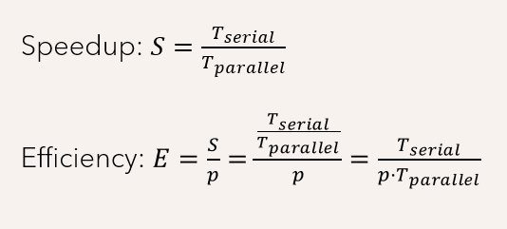
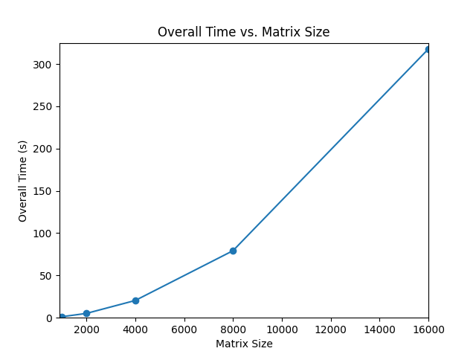
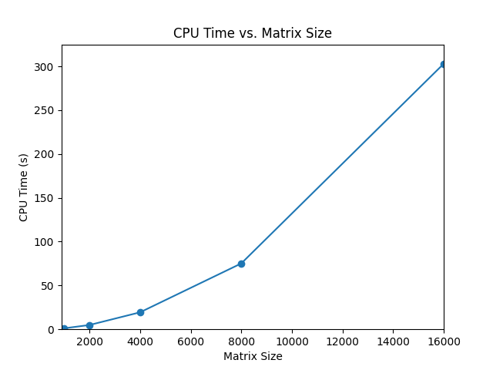
Results Analysis: Evaluation Metrics & Serial Performance

Slide 22
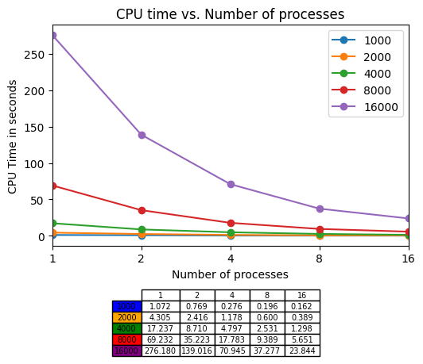
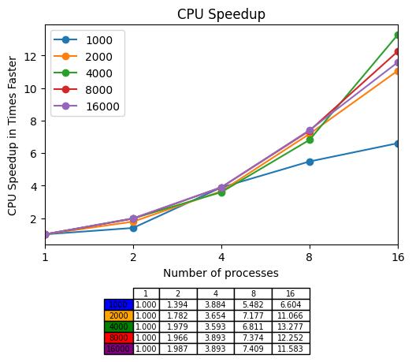
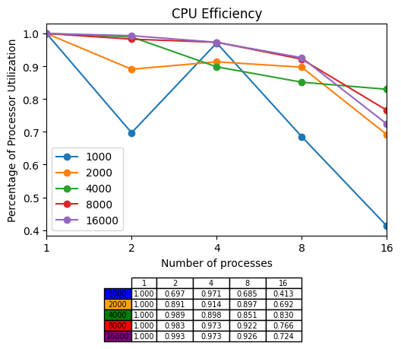
Results Analysis: Pthreads (CPU)

Slide 23
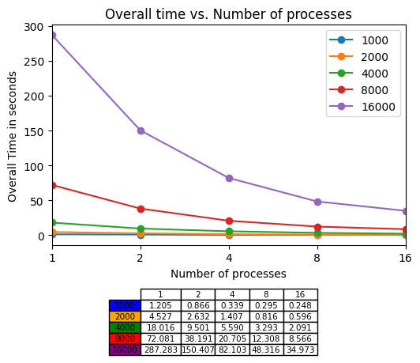
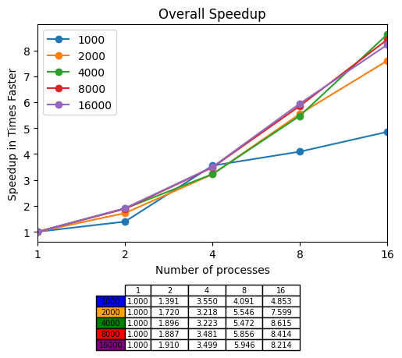
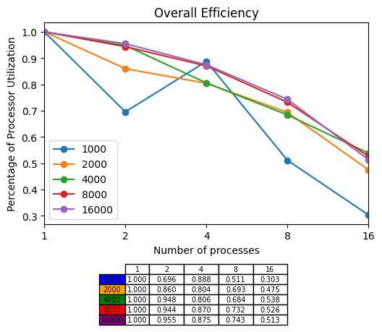
Results Analysis: Pthreads (Overall)

Slide 24

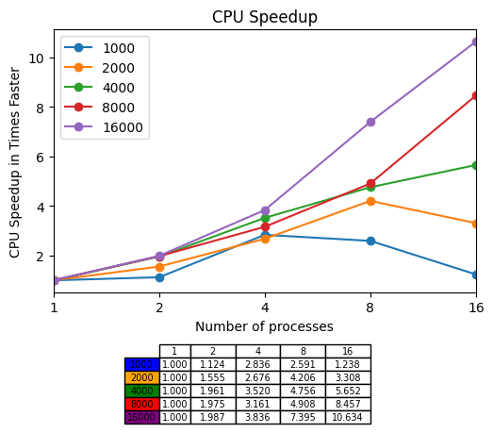
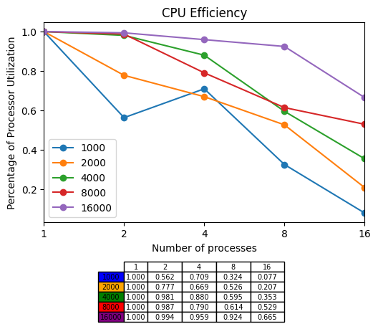
Results Analysis: MPI (CPU)

Slide 25

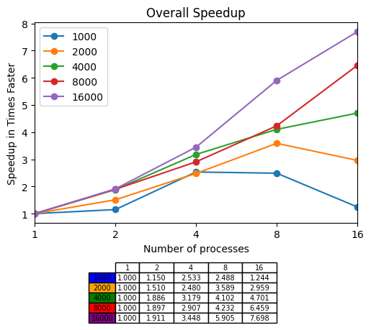
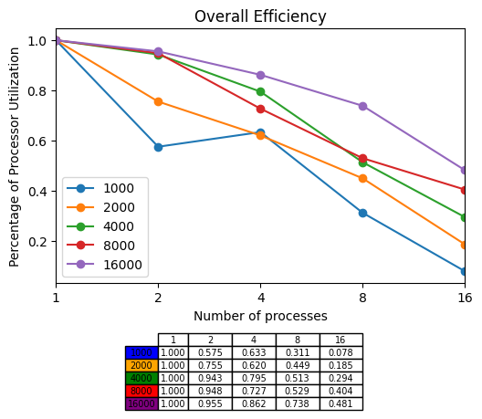
Results Analysis: MPI (Overall)

Slide 26
Roadmap
Preliminary Knowledge on Parallel Computing
An Overview of Our Experiment
Design
Experimentation
Results Analysis
Matrix Stencil Animations
Conclusion

Slide 27
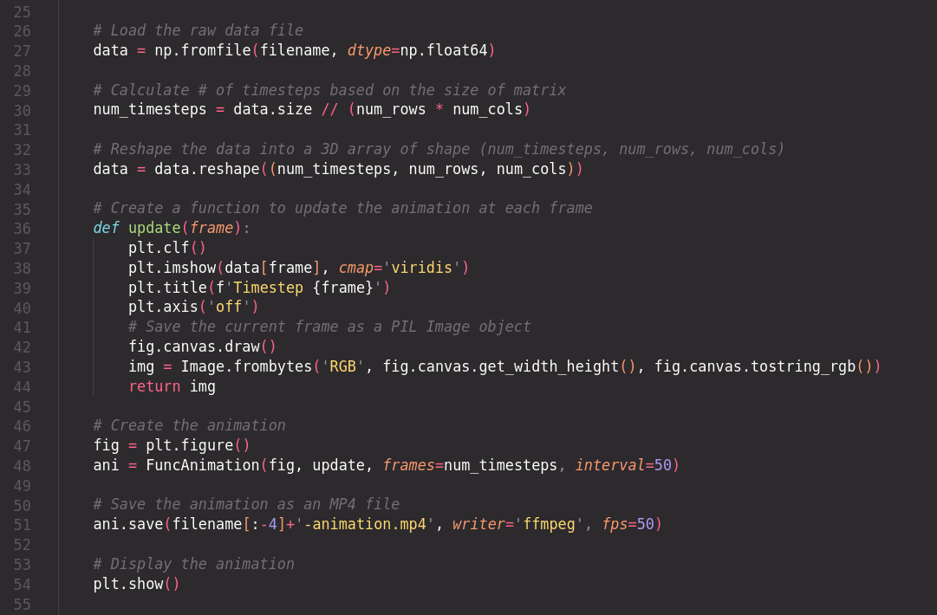
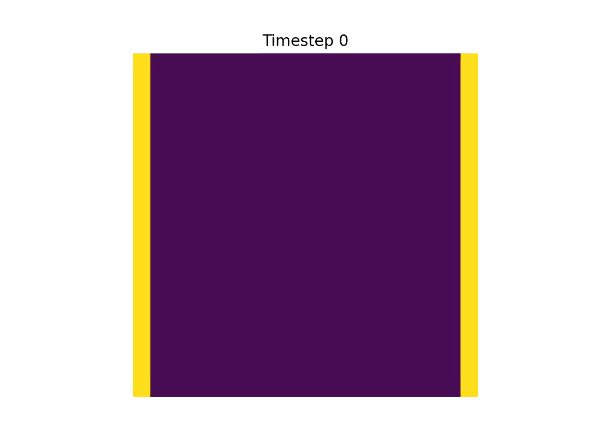
Console Apps
Matrix Stencil Animations

Slide 28
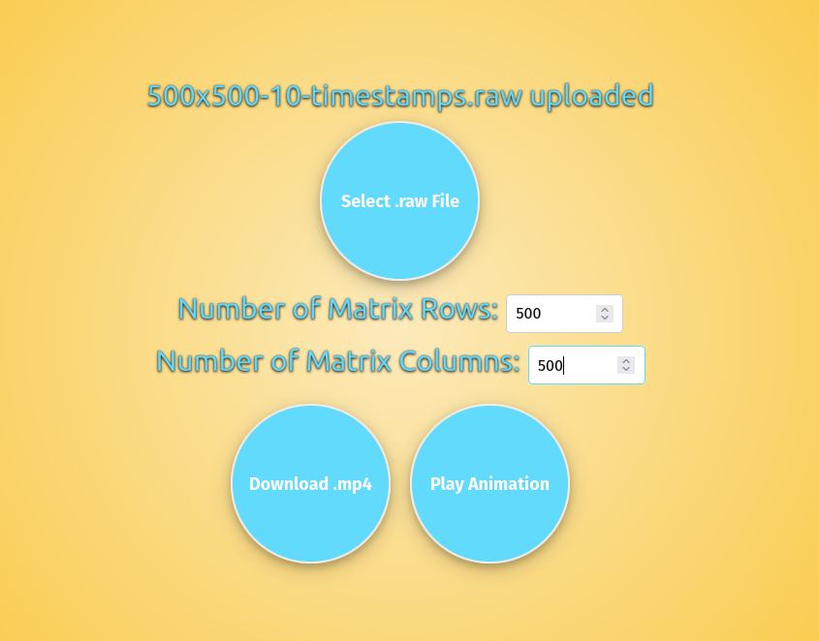
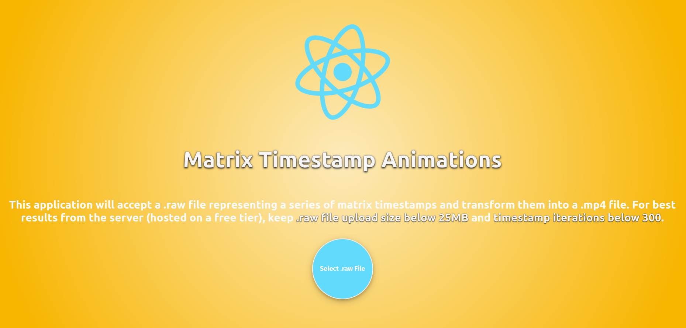
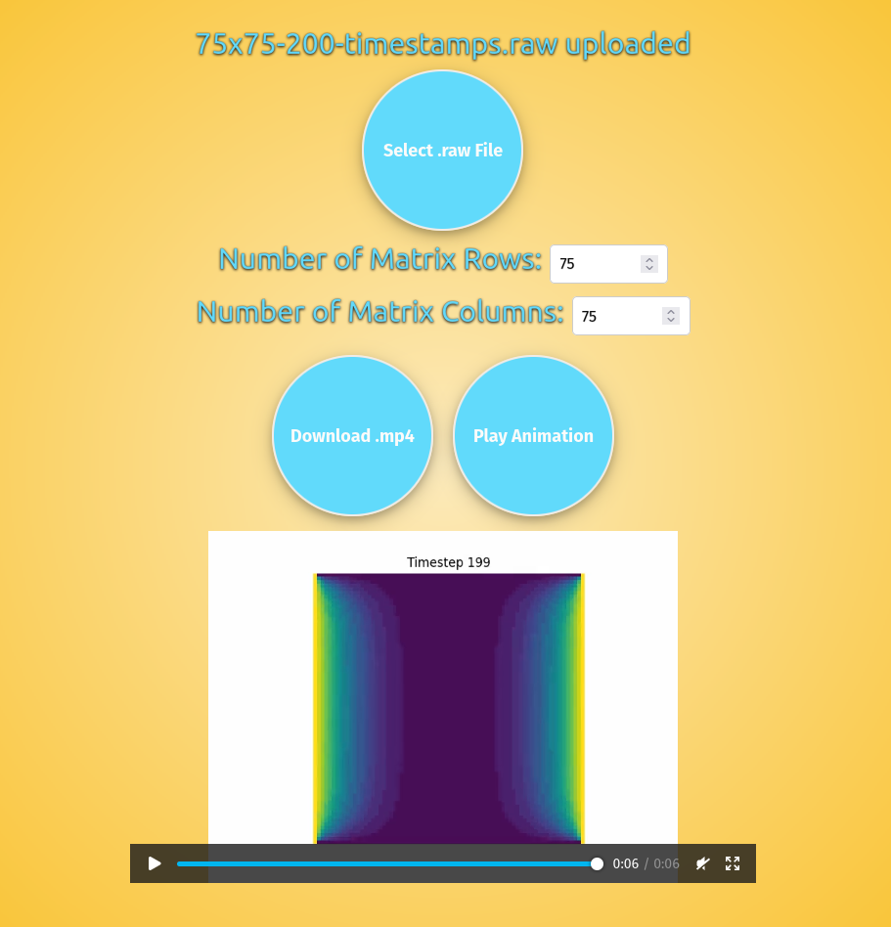
Web App URL: www.matrix-animations.com Download Files & Play Online
Matrix Stencil Animations

Slide 29
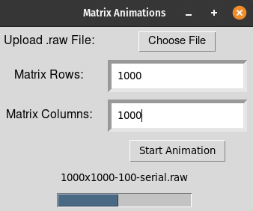
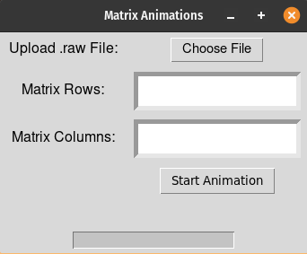
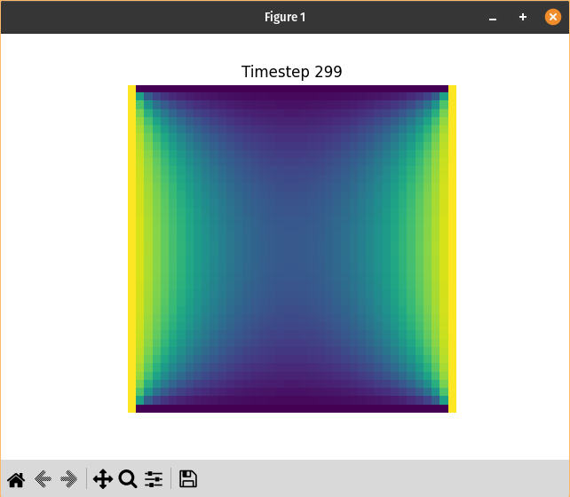
Desktop App
Matrix Stencil Animations

Slide 30
Roadmap
Preliminary Knowledge on Parallel Computing
An Overview of Our Experiment
Design
Experimentation
Results Analysis
Matrix Stencil Animations
Conclusion

Slide 31

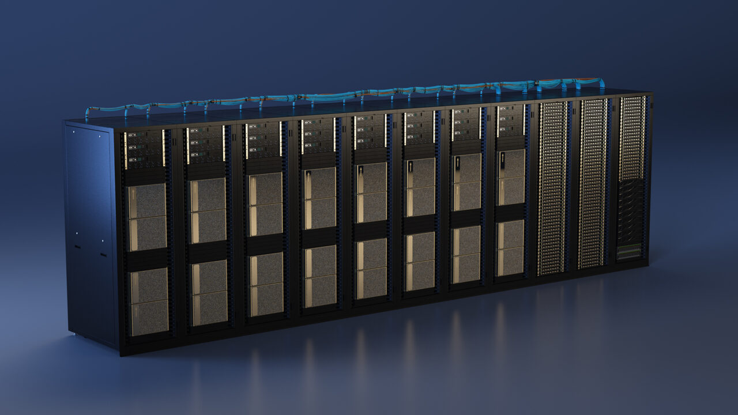
Conclusions

